Slide 1

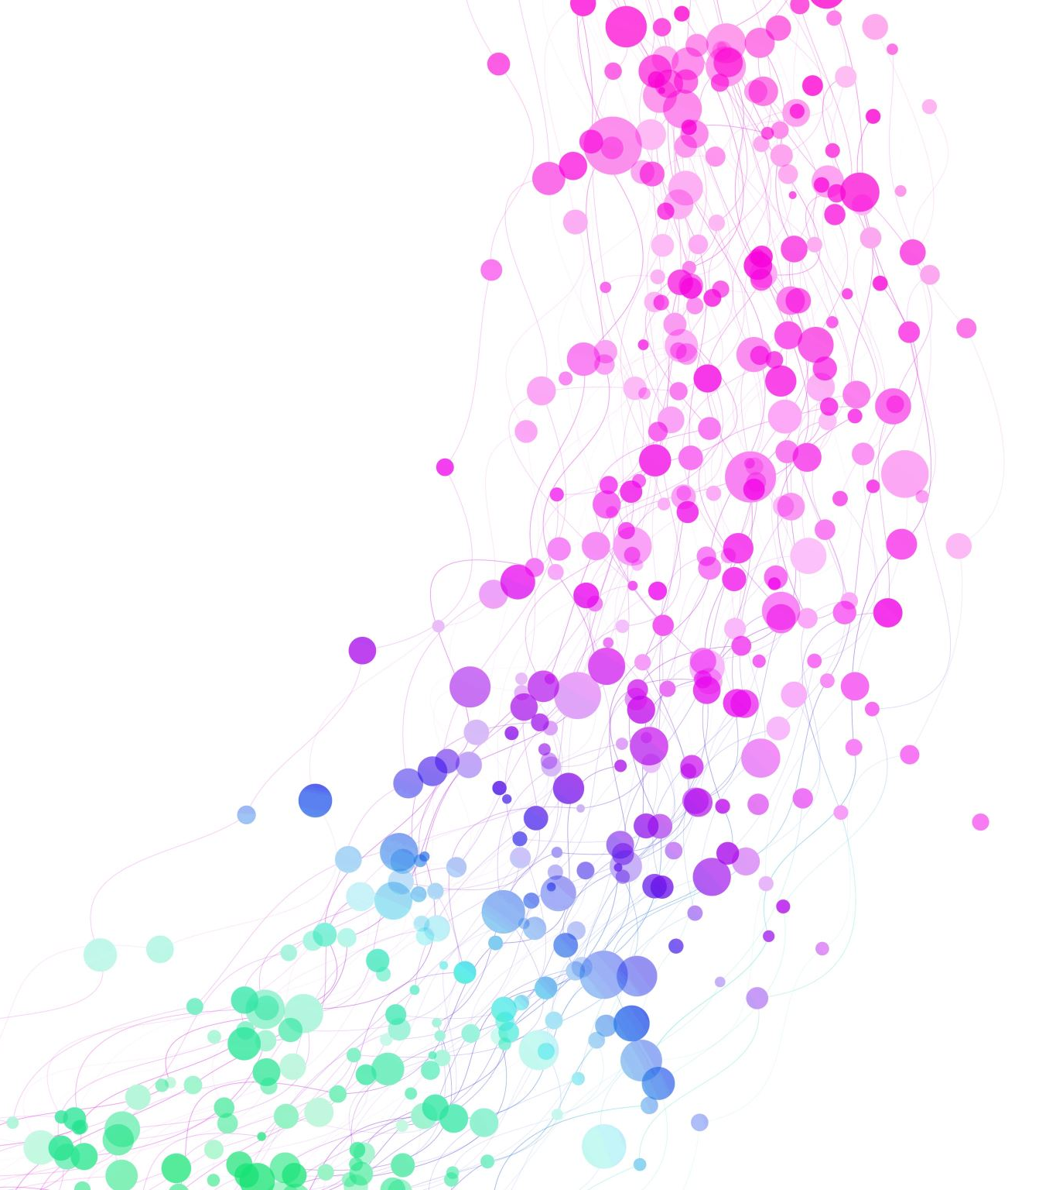
Sprint 1
Gowtham Raj K R

Slide 2

Index
Agile Methodology and Scrum
Cloud and Its Deployment Models
Cloud Service Models
Azure Fundamentals
Terraform

Slide 3
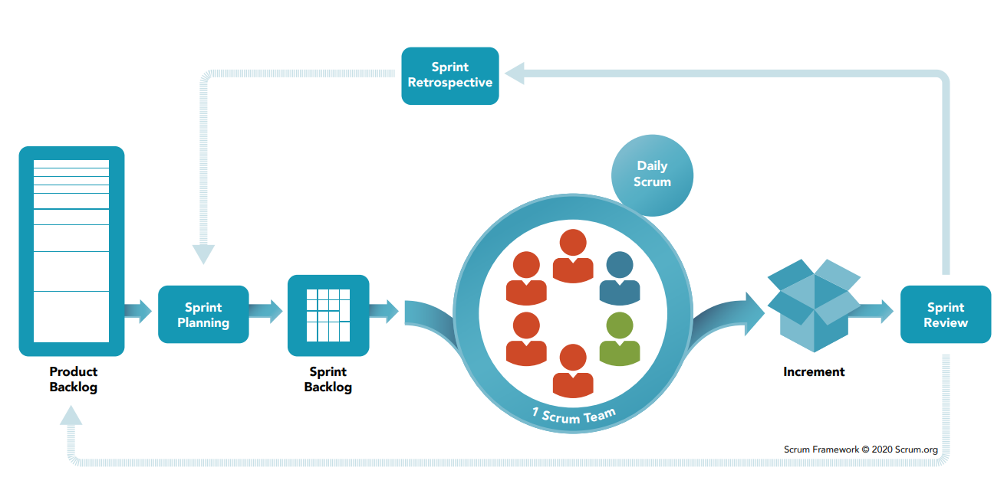
Agile Methodology and Scrum
Scrum Values
Commitment, Focus, Courage, Openness, Respect

Slide 4
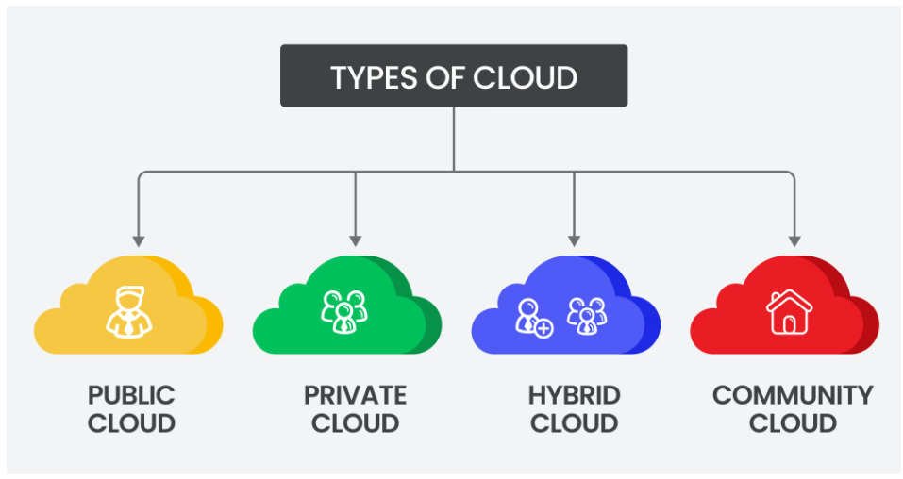
Cloud and its Deployment Models

Slide 5

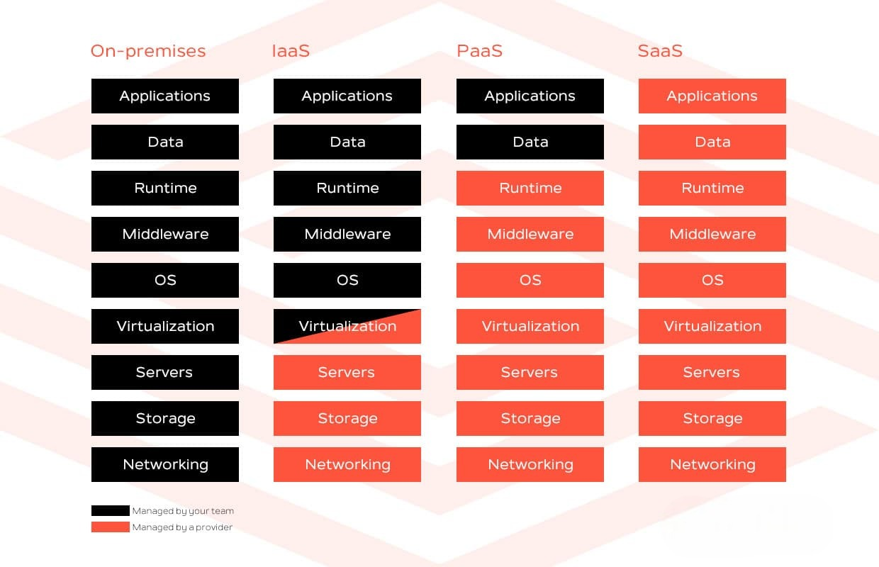
Cloud Service models
Notes:
These deployment models will helps the organizations to reduce the costs spending on servers according to their needs, organization can customize the model.

Slide 6
Azure Fundamentals
Azure Virtual Machine
Azure Storage
Azure Network Security Groups
Azure IAM (Identity and Access Management)
Azure Management and Governance
Azure Virtual Network

Slide 7
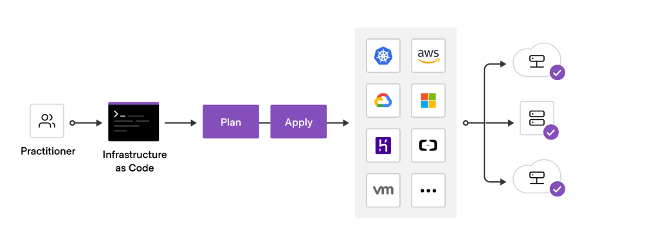
Terraform (Infrastructure as a code)

Slide 8
Terraform Main Commands
terraform init
terraform plan
terraform validate
terraform apply
terraform destroy

Slide 9


